Slide 1
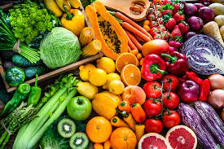
HEALTHY FOOD
GOOD HEATHY
SENGHAK CHUUN

